Slide 1
Global Climate Trends & Utilization of Sustainable Energy
October 15, 2024

Slide 2
Overview
Topic: Worldwide Climate Trends
Main point: How have the rise in temperatures over several years affected different parts of the world, and what affects those rises on a country-to-country basis.
Our group wanted to look into the topic of worldwide climate trends over the past several years. We wanted to see how the rise in temperature over several years affected different parts of the world, how many of these countries are using sustainable energy, and if that is making a difference.

Slide 3
Data Sourcing
Sources
https://www.kaggle.com/datasets/jawadawan/global-warming-trends-1961-2022
This dataset looks at annual surface temperatures for over 100 countries spanning from 1961-2022.
https://www.kaggle.com/datasets/anshtanwar/global-data-on-sustainable-energy
This dataset looks at sustainable energy factors across over 100 countries from 2000 to 2020.
Cleanup
Merge the two csv files on “Country” to make one large energy table.
Note the columns and replace null values with zeros
Remove unnecessary columns
Make a copy of main energy table and filter out columns so that it only contains temps and emissions data.
Convert annual surface temps to fahrenheit
Rename year columns to appropriate variable + year
Save the filtered_energy_table and filtered_temps_emissions_table as CSV’s and to SQLite Database

Slide 4
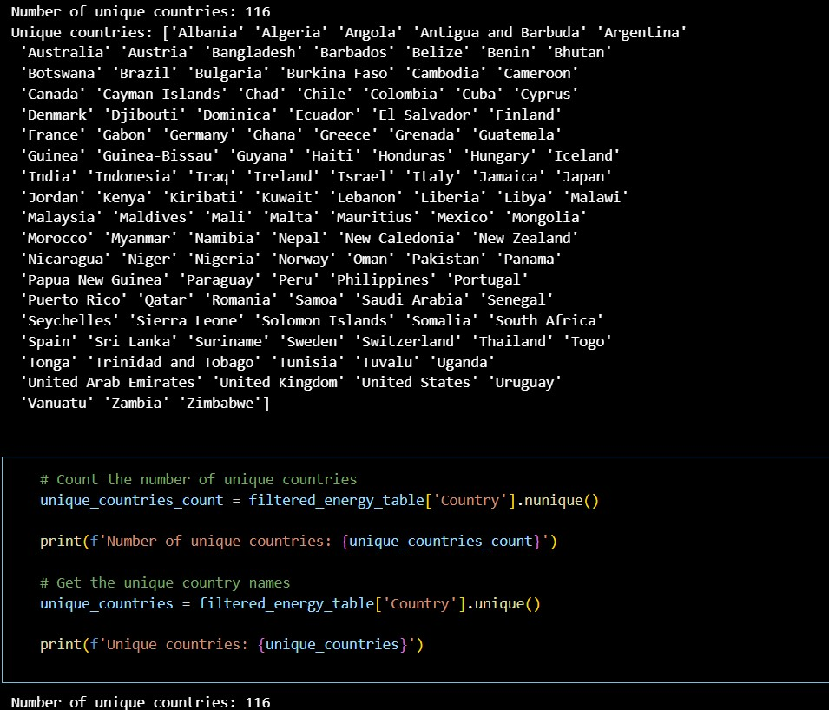
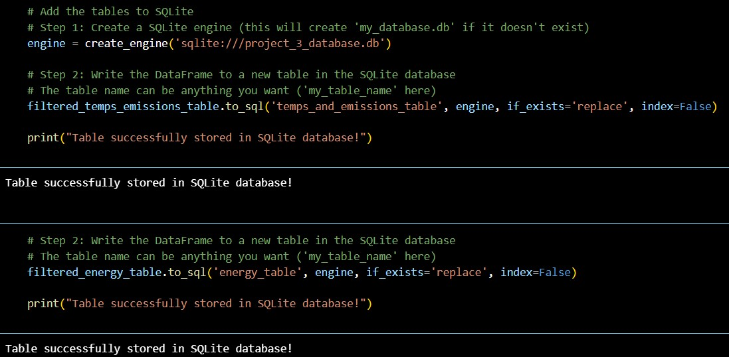
The snippet of code to the left shows our unique record count: 116 countries were examined in our dataset!
The snippet of code to the right shows how we added our tables into the SQLite database!

Slide 5
Main Questions

Slide 6
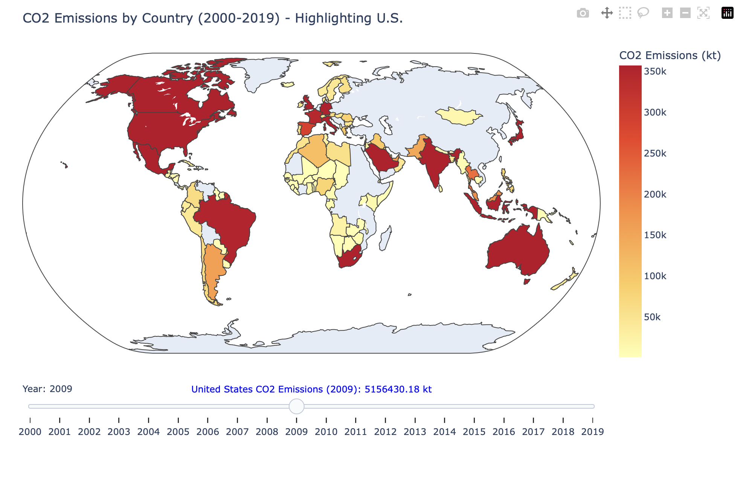
CO2 Emissions
The Idea: Visually assess each country’s Carbon Dioxide emissions over a period of several years
Why: to establish a good baseline for which countries are heavy polluters, as well as finding countries that decrease pollutants over the shown period to watch for later in the dataset.
Code Insights: The basis for the Emissions Cloropleth Map code was built using the code found in one of our Kaggle notebooks (link). The code was modified based on our clean CSV data.
Problems: The US’s emissions being measured in the millions made displaying the decrease in emissions it characterized difficult, so we included a highlight feature that displayed it’s CO2 emissions in a separate blurb on the bottom of the page.

Slide 7
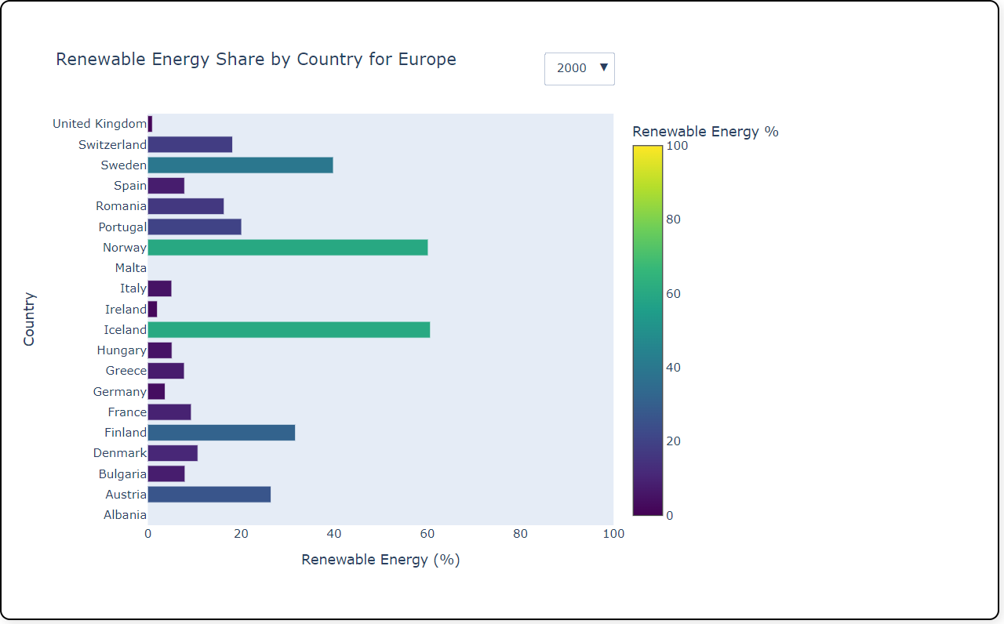
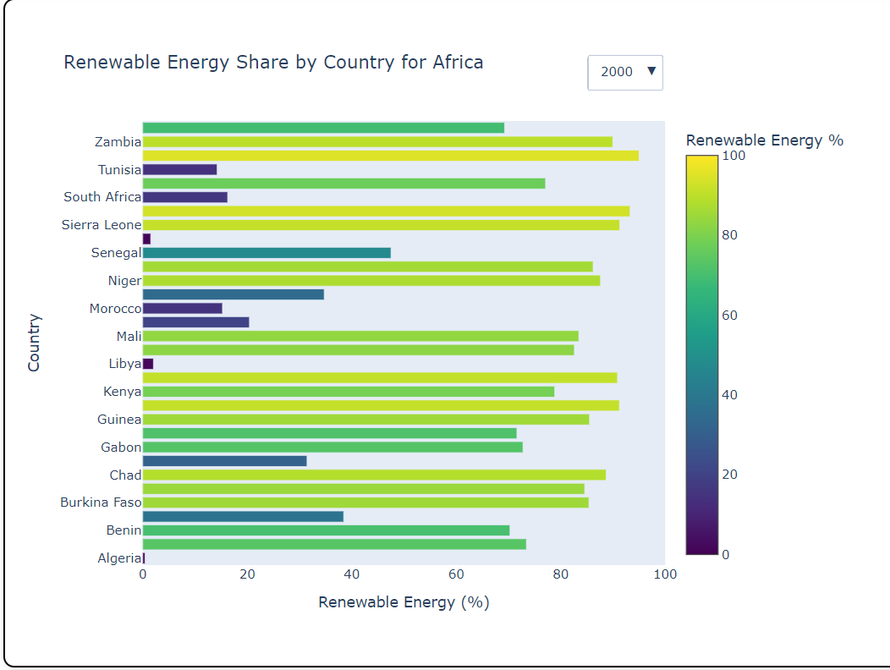
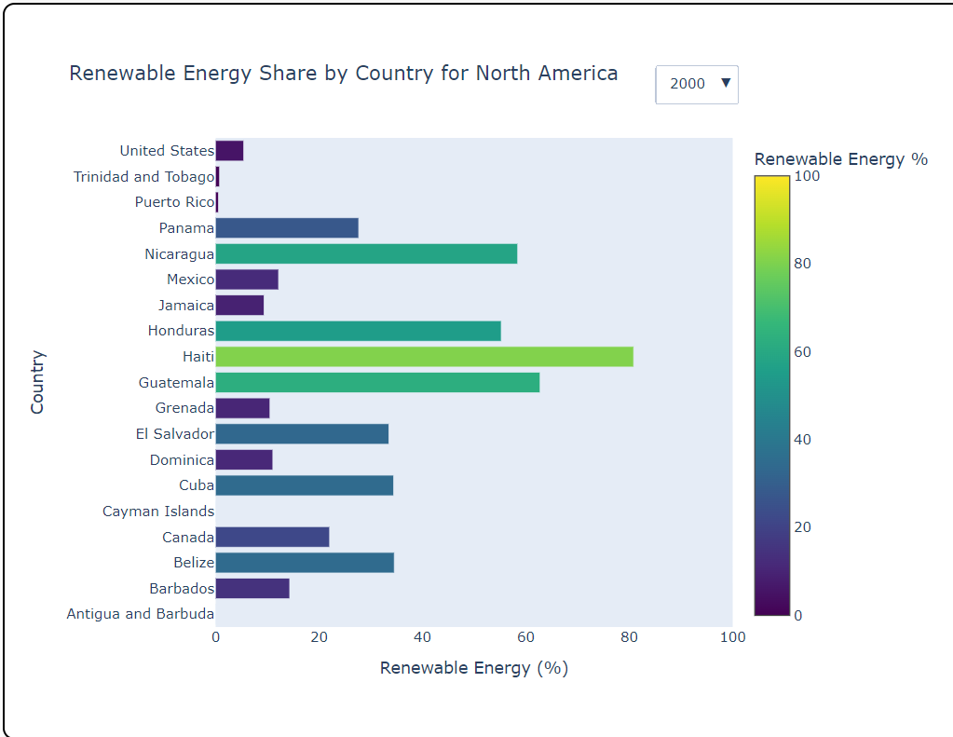
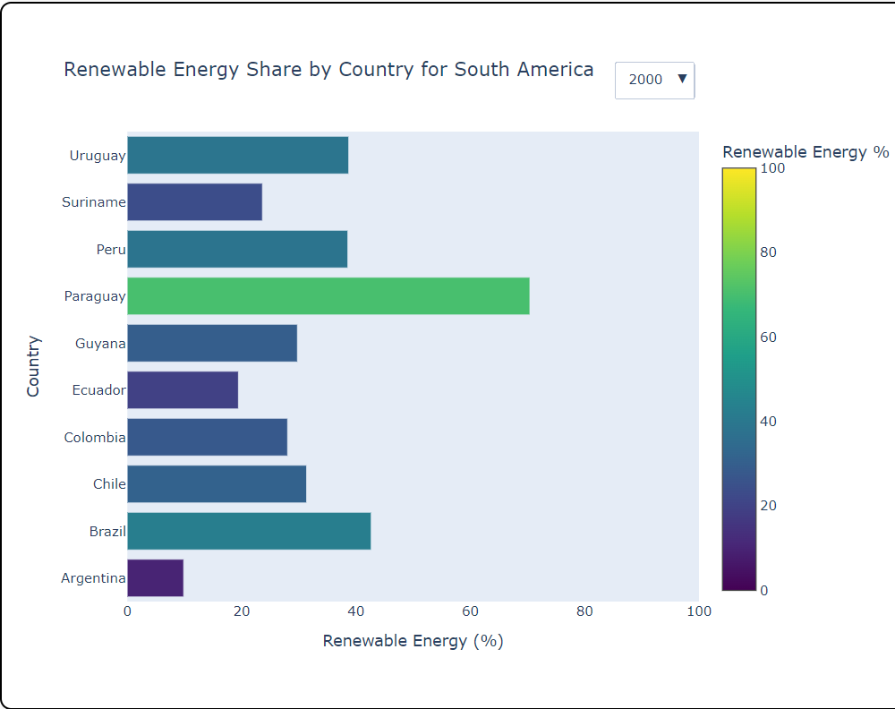
Sustainable Energy
The Idea: Visually assess the percentage of each country’s energy production and its sustainability from 2000 to 2019.
Why: To identify which countries are leading the way for sustainability and which countries have fallen behind. It also provides us with understanding of the regional differences and what may be impacting these factors, such as geopolitical and socio economic challenges.
Code Insights: For loop was used to create a bar chart (plotly) for each region based on continent. Each chart contains a gradient color scale based on the renewable energy amount and a drop down to select the year. Hover text is also used to give the exact percentage for each country
Problems: The visualization was too crowded when all countries were listed at once. Instead we included a dictionary of each continent and separated the visualization by regions

Slide 8
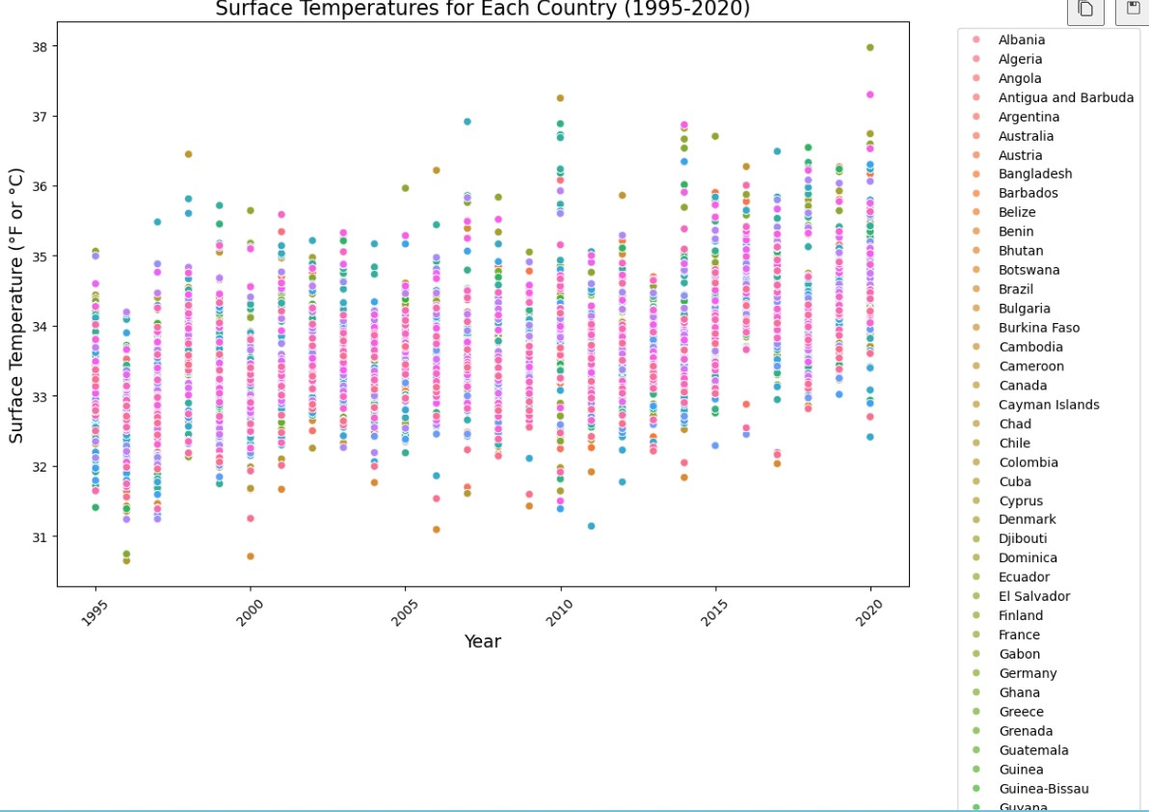
Annual Temp. Averages
The Idea: Assess each country’s surface temperature from 1995 - 2020.
Why: To identify any noticable differences in surface temperatures. We can look to see if any correlation between temperature increase and increase in energy production and CO2 emissions.
Code Insights: Reshaped dataframe to a long format so each row corresponds to single surface temp for a given country. Cleaned the Year column to convert the values to integers. Assigned each country to their corresponding continent. Plotted with seaborn to create a scatter plot. Finally plotted with Plotty to create a interactive scatter plot.
Problems: Unable to utilize Seaborn fully for this visualization. Seaborn was used to create an initial scatter plot. To make the visualization interactive, Plotly was used for the scatter plot.

Slide 9
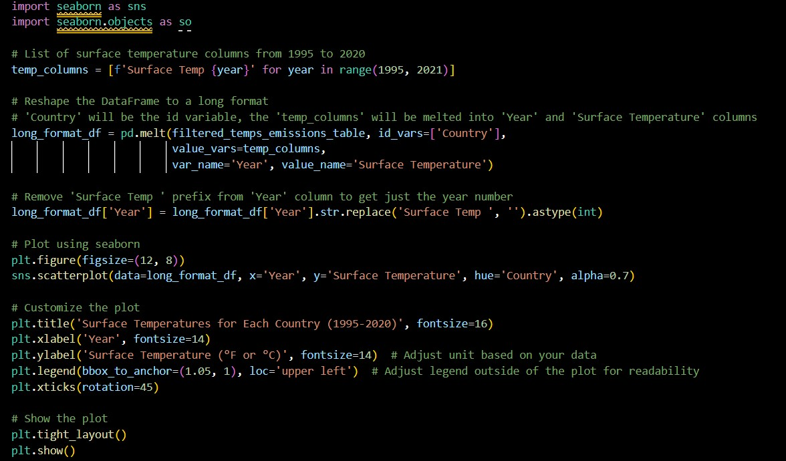
New Python Library- Seaborn!
Seaborn is a Python library that offers a robust set of statistical data visualization tools built off of matplotlib. Unfortunately, Seaborn does not have much interactive capability, This limited our visualization to one scatter plot for the entire category of data we were looking at, and led to overcrowding.

Slide 10
Demonstration:
Interactive Data Visualizations
<<< Demo index page here >>>

Slide 11
Conclusions Drawn
USA’s CO2 emissions were the highest in the world.
Countries with noticeable decreases in CO2 emissions: USA, Spain, France, UK
The region with the greatest amount of renewable energy across its countries is Africa.
Somalia has the highest percentage of renewable energy in 2019 at 95.03% and Uganda has the second highest percentage at 90.22%.
Africa is also one of the lowest-polluting continents, as shown by the cloropleth map.
There was not a significant change in surface temp across all continents for this time frame.
What story does this data tell us when taken together?

Slide 12
Next Steps
Further research on what impacts an increase or decrease on emissions (ie. factory production, outsourcing, population increase/decrease)
Look at geopolitical and socio-economic factors that can impact renewable energy (ie. war, famine, natural disasters)
Longer period of time for noticeable differences in surface temperature (100 years versus 25 years)

Slide 13
> Questions?

Slide 14




The Team
Andrew Pohle
Caitlin Mcmahill
Jessica Maranto
Lauren Graves
Main Visualization Index Creator
CO2 Emissions Visualization Creator
Surface Temperature Visualization Creator
Data Custodian
Sustainable Energy Visualization Creator

